Slide 1

WEB API Core
Nobel It solutions

Slide 2
What is ASP.Net Core Web API?
ASP.NET Core Web API is a framework for building scalable and high-performance Restful Web Services (APIs) using the ASP.NET Core platform. It allows developers to create robust and flexible APIs that various clients can consume, such as web applications, mobile apps, desktop applications, and third-party services.
Why Web API-
ASP.NET Core Web API is a framework for building scalable and high-performance Restful Web Services (APIs) using the ASP.NET Core platform. It allows developers to create robust and flexible APIs that various clients can consume, such as web applications, mobile apps, desktop applications, and third-party services.
Web APIs provide a flexible way to access and manipulate data. They allow developers to create custom client applications that can consume these APIs based on their specific needs.
They facilitate integration between different services and applications. For instance, a weather forecasting service may expose a Web API that other applications can query to get weather data, which they can then integrate into their own functionality.

Slide 3
Examples
Social Media Integration: When a website integrates Facebook login, it uses Facebook’s API to authenticate users.
Payment Gateways: E-commerce sites use APIs from payment processors like PayPal or Stripe to handle transactions.
Weather Data: Apps that provide weather updates use APIs from weather services to fetch real-time weather data.
Google Maps API: Allows developers to embed maps and location services into their applications.
Twilio API: Enables applications to send SMS, make phone calls, and manage communications.

Slide 4
Characteristics of WEB APIs
HTTP-Based Communication: Web APIs are designed to work over HTTP, the same protocol used for Web Browsing. This means APIs can be accessed using standard HTTP methods like GET, POST, PUT, DELETE, etc. The API endpoints are typically represented as URLs (Uniform Resource Locators).
Data Exchange Formats: Web APIs use standardized data exchange formats such as JSON (JavaScript Object Notation) and XML (Extensible Markup Language) to structure and transmit data between the client and server. JSON has become the most popular format due to its simplicity and ease of use.
RESTful Architecture: Web APIs are designed to follow Representational State Transfer (REST) principles. A RESTful API is stateless, uses standard HTTP methods, and organizes resources into a hierarchy with unique URLs for each resource.
Authentication and Authorization: Web APIs implement security mechanisms for authentication and authorization to ensure that only authorized clients can access resources or perform specific actions. Common authentication methods include API keys, OAuth, and JWT (JSON Web Tokens).

Slide 5
HTTP(Hyper Text Transfer Protocol)
HTTP stands for Hypertext Transfer Protocol. It is the foundation of data communication for the World Wide Web. It defines how messages are formatted and transmitted and how web servers and browsers should respond to various commands. HTTP operates as a request-response protocol between a client (typically a web browser) and a server.
Why do we need HTTP?
It is the primary protocol for web browsing and data communication over the internet. Understanding HTTP is essential for web development for several reasons, such as:
Web Development: Knowing how data is exchanged allows you to build more efficient web applications.
Troubleshooting: Knowledge of HTTP helps diagnose and solve web-related issues.
For example, as a web developer, knowing how HTTP status codes work can help you understand why a request failed and how to fix it.

Slide 6
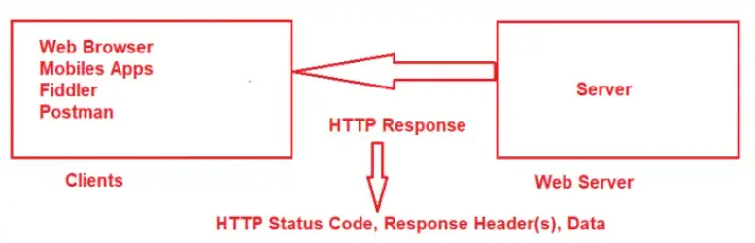
HTTP Request/HTTP Response

Slide 7
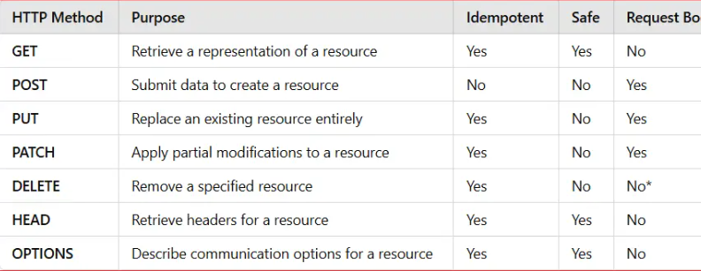
HTTP Methods
Idempotent HTTP Methods: A method is considered idempotent if executing the same request multiple times has the same effect as making it just once. In other words, no matter how many times we perform the operation, the final result on the server is the same as doing it once. Methods like GET, HEAD, PUT, DELETE, and OPTIONS are generally idempotent. POST is typically not idempotent because each additional identical POST request could create or modify a new resource again.
Safe HTTP Methods: A method is considered safe if it does not modify the server’s state. In other words, it should only retrieve data or information. Performing a safe method multiple times should not have any side effects (e.g., updating or deleting data). Standard safe methods include GET, HEAD, and OPTIONS.

Slide 8
HTTP Status Code
HTTP status codes are essential components of HTTP responses sent by servers to clients. They are three-digit numbers returned by the server to inform the client about the outcome of their request, whether the request was successful, encountered errors, or requires further actions.
1xx (Informational Responses): The request is being processed.
2xx (Successful Responses): The request was successfully received, understood, and accepted.
3xx (Redirection Responses): Further action is needed to complete the request.
4xx (Client Error Responses): There was an issue with the client’s request.
5xx (Server Error Responses): The server encountered an issue processing the request.

Slide 9
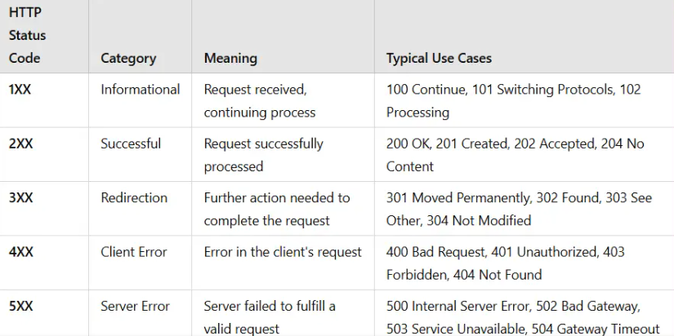

Slide 10
Swagger
Swagger, often implemented using the Swashbuckle package, is a powerful tool used for documenting RESTful APIs developed with ASP.NET Core Web API. It provides a way to help plan, design, and document RESTful APIs. Swagger in ASP.NET Core Web API helps developers create, document, and consume RESTful APIs.
To configure Swagger API, we need to add the AddEndpointsApiExplorer() and AddSwaggerGen() services to the built-in dependency injection container within the Main method of the Program class, as shown in the code below. Both AddEndpointsApiExplorer and AddSwaggerGen are typically used together when setting up a project that uses Swagger for documenting APIs.
AddEndpointsApiExplorer() Service: The AddEndpointsApiExplorer() method configures the API Explorer service, which is responsible for providing metadata about API endpoints in our ASP.NET Core application.
Names of Controllers and Actions.
Supported HTTP methods (GET, POST, PUT, DELETE, etc.).
Route templates and parameters.
Data types of input and output parameters.

Slide 11
Swagger services
AddSwaggerGen() Service:
AddSwaggerGen is a method from the Swashbuckle.AspNetCore package that adds Swagger generation services to the project. It generates the Swagger/OpenAPI specification document (swagger.json) based on the API metadata provided by the API Explorer. AddSwaggerGen configures and initializes the generation of the OpenAPI specification, which includes information about all the paths, operations, and information flows of your API.
Enable Swagger Middleware Components:
Once we configure the Swagger API services to the built-in dependency injection container, we need to register the Swagger Middleware components in the Application Request Processing Pipeline.

Slide 12
Controllers in Web API
Request Handling: Controllers receive HTTP requests and route them to the appropriate action methods. Each action method within a controller generally corresponds to a specific type of HTTP request (e.g., GET, POST, PUT, or DELETE).
Data Processing: Controllers interact with models and services to process data, implement business logic, and perform operations such as querying a database to perform database CRUD Operations, applying business rules and validations, or transforming data for the client.
Response Generation: Based on the outcome of the processing, controllers generate HTTP responses which will return to the client. These responses can include data payloads (e.g., JSON, XML, etc.), status codes (e.g., 200 OK, 404 Not Found, 400 Bad Request, etc.), and error messages.

Slide 13
ControllerBase Class
It serves as a lightweight base class for Web API controllers that do not require view support.
Core MVC Features: Provides access to essential functionalities like action methods, routing, model binding, and HTTP context manipulation.
No View Support: This does not include support for rendering views (e.g., HTML or Razor views), making it ideal for APIs that solely return data.
Helper Methods: Offers various helper methods such as Ok(), NotFound(), BadRequest(), etc., to facilitate standard HTTP responses.
Lightweight: Eliminates the overhead associated with view rendering, resulting in better performance for API endpoints.
Use Case: Building RESTful APIs that return data in formats like JSON or XML without needing server-side rendered views.

Slide 14
Contoller Class
It extends the ControllerBase class by adding support for view-related functionalities, making it suitable for MVC applications that render server-side views. It supports all the features ControllerBase Class supports and additional features designed explicitly for MVC applications.
All ControllerBase class Features: Inherits all core functionalities provided by ControllerBase.
View Support: Includes methods and properties for rendering views, such as View(), PartialView(), and access to ViewBag and ViewData.
Additional Functionality: Provides capabilities related to managing and rendering HTML views using Razor syntax.
Use Case: Developing traditional MVC applications where controllers handle both data endpoints and server-side view rendering.

Slide 15
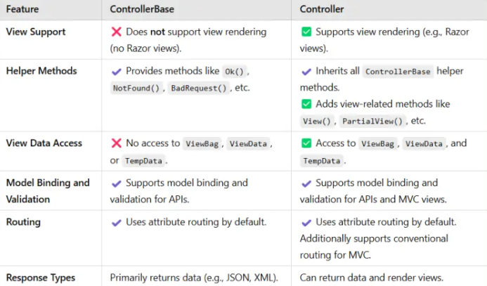
ControllerBase Vs. Controller

Slide 16
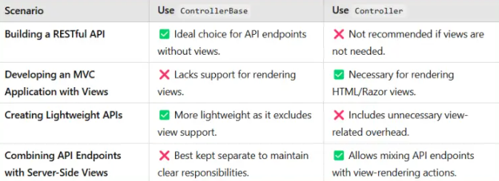
When to use

Slide 17
Models in WEB API
In ASP.NET Core Web API, Models are classes that represent the data and business logic of the application. They define the structure, relationships, and constraints of the data that the application manages. Models play an important role in data persistence, data validation, and data transfer between the client and server. The following are the Key Features of Models in ASP.
Data Representation: Models are typically Plain Old CLR Objects (POCOs) that define the properties corresponding to the data fields. They can represent entities stored in a database, encapsulating both the data and related business logic.
Data Annotations for Validation: Models can be decorated with attributes from the System.ComponentModel.DataAnnotations namespace to enforce validation rules. Common annotations include Required fields [Required], String length [StringLength], Range constraints [Range], and Format Validaions [RegularExpression], which help ensure data integrity and correctness.
Defining Relationships: Models can define relationships between different entities using navigation properties. For example, a Product model might have a foreign key to a Category model, establishing a one-to-many relationship.
Data Transfer Objects (DTOs): Models can serve as DTOs, which are specialized objects used to transfer data between the client and server. DTOs help in shaping the data exposed by the API, allowing us to hide sensitive information and include only necessary fields.
Entity Framework Integration: When using Entity Framework Core (EF Core) for data access, models are mapped to database tables. EF Core uses models to perform CRUD (Create, Read, Update, Delete) operations on the database.

Slide 18
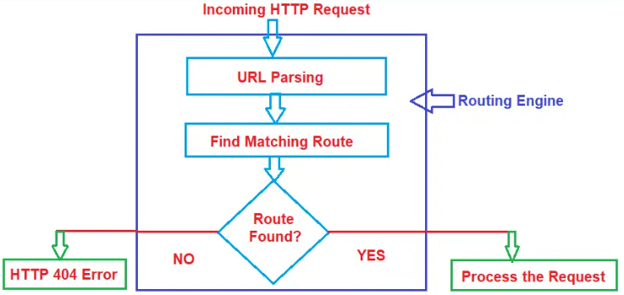
Routing in Web API
Routing in ASP.NET Core is a concept that is used to map the incoming HTTP requests to specific controller actions in our application. When a request comes in, the Routing Engine inspects the URL (and possibly other data like HTTP method, Route Data, etc.) and determines which action method of which controller should handle it.

Slide 19

Types of Routing- Conventional Based
Convention-Based Routing: Configured globally, typically in the Program.cs file.
Convention-based routing defines URL patterns and maps them to controller actions based on predefined conventions. This approach centralizes route configuration, making it easier to manage, especially in applications with numerous controllers and actions. This routing style is ideal for situations where the routes follow a predictable structure, making it easy to manage and maintain.In the Program.cs class file, convention-based routing is typically configured using the MapControllerRoute method.
Routes are defined in one place, usually in Program.cs.
Follows a consistent URL structure, enhancing readability and maintainability.
It is ideal for applications where many endpoints follow similar patterns. That means Conventional Routing is often preferred for applications with a consistent URL structure across many controllers and actions.
Commonly used in ASP.NET Core MVC Web Applications.

Slide 20
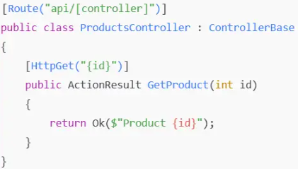
Types of Routing-Attribute based
Attribute-Based Routing: Configured using attributes applied directly to controllers and action methods.
Attribute-based routing allows developers to define routes directly on controllers and action method levels using attributes. This approach provides more flexibility and control over the routing behavior, making it suitable for APIs with complex or unique URL structures.
The following are the Key Characteristics of Attribute-Based Routing in ASP.NET Core Applications:
Routes are defined alongside their corresponding actions, improving clarity.
Enables complex and customized routes for specific needs.
Allows individual actions to have distinct routes independent of global patterns.
Commonly used in ASP.NET Core Web API Restful Services.

Slide 21
HTTP-Methods
HTTP (Hypertext Transfer Protocol) methods are standardized request methods used in HTTP to specify the desired action performed on a specific resource in a web application. They are key components of RESTful APIs, allowing clients and servers to interact and manipulate resources effectively. These methods tell the web server what operation should be executed for a particular resource, such as retrieving data, creating new entries, updating resources, or deleting them.
HTTP GET Method:
The HTTP GET Method retrieves data from the web server without modifying the resource. It is safe to call multiple times without changing the server state. For example, if you request a list of all users from a server, the server responds with the user data without modifying any existing information. We need to decorate the action method with the HttpGet attribute in ASP.NET Core Web API.
HTTP POST Method:
The HTTP POST method sends data to the server to create a new resource. It usually includes data as part of the request body, with the type specified by the Content-Type HTTP header. A common use case for POST is submitting a registration form to create a new user in the system. Each POST request creates a distinct user entry. We need to decorate the action method with the HttpPost attribute in ASP.NET Core Web API.

Slide 22
HTTP-Methods
HTTP PUT Method:
The HTTP PUT method replaces all the current representations of the target resource with the request payload. It typically updates an existing resource. If the resource does not exist, the server may create a new resource at the specified URI (depending on the server implementation). For example, it may update a user’s profile information by replacing all existing details with the new data provided. We need to decorate the action method with the HttpPut attribute in ASP.NET Core Web API.
HTTP PATCH Method:
The HTTP PATCH method allows partial modification of a resource. It sends only the changes to be applied rather than the entire resource. Unlike PUT, it doesn’t replace the whole resource; instead, it only updates specific fields. For example, it updates just the email of a user profile without affecting other attributes. We need to decorate the action method with the HttpPatch attribute in ASP.NET Core Web API.
HTTP DELETE Method:
The HTTP DELETE method removes a specified resource from the server, such as a user account, from the database. We need to decorate the action method with the HttpDelete attribute in ASP.NET Core Web API.

Slide 23
HTTP-Methods
HTTP HEAD Method:
Like GET, the HTTP HEAD method requests the resource’s headers without the response body. It retrieves the headers of a resource. It is commonly used to check metadata, such as content type and length, before making a full GET request. For example, check the size of a large file before downloading it without downloading the content. We need to decorate the action method with the HttpHead attribute in ASP.NET Core Web API.
HTTP OPTIONS Method:
The HTTP OPTIONS method describes the communication options for the target resource. It allows clients to determine which HTTP methods the server supports for a specific resource. It is commonly used in Cross-Origin Resource Sharing (CORS) preflight requests to check what methods and headers are allowed. For example, determining if the server supports the PUT method for a particular endpoint before attempting to update a resource. We need to decorate the action method with the HttpOtions attribute in ASP.NET Core Web API.

Slide 24
CORS in WEBAPI
What is CORS?
CORS (Cross-Origin Resource Sharing) is a mechanism that allows servers to specify which origins are allowed to access their resources. It enables a web application running at one origin (domain) to make requests for resources on a different origin. CORS headers are added to server responses to tell the browser whether to allow or deny cross-origin requests. That means it is a way to bypass the Same-Origin Policy (SOP) by allowing servers to specify who can access their resources.
CORS is configured on the server side by adding specific HTTP headers (e.g., Access-Control-Allow-Origin, Access-Control-Allow-Methods, and Access-Control-Allow-Headers) to the response. These headers instruct the browser on how to handle the request based on the origins, methods, and headers allowed.

Slide 25
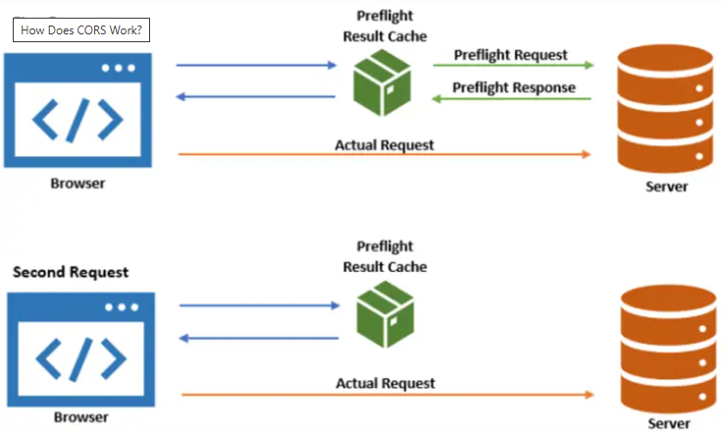
How Does CORS Work?
When a client application sends an AJAX request to Web API hosted on a different origin, the process involves several steps that ensure the request is safe and adheres to the server’s CORS policy

Slide 26
CORS
First Request (Initial Preflight Request)
Browser Sends a Preflight Request:
When the browser detects that a cross-origin request is being made (e.g., from http://example.com to http://api.example.com), it sends a preflight request first. This preflight request is an HTTP OPTIONS request sent to the server, which includes information about the intended HTTP method and headers of the actual request. This preflight request checks whether the server permits the actual request based on the method (e.g., GET, POST) and headers (e.g., custom headers).
Server Responds to the Preflight Request:
The server evaluates the preflight request and decides whether the actual request is allowed based on its CORS policy. If the server allows the request, it sends a preflight response with appropriate headers (e.g., Access-Control-Allow-Origin, Access-Control-Allow-Methods, and Access-Control-Allow-Headers). The following are the Preflight Response Headers:
Access-Control-Allow-Origin: Specifies which origins are allowed.
Access-Control-Allow-Methods: Specifies which HTTP methods are allowed.
Access-Control-Allow-Headers: Specifies which request headers are allowed.
Access-Control-Max-Age: Specifies how long the preflight result can be cached.
Preflight Result Caching:
The browser caches the result of the preflight response for a certain duration (controlled by the Access-Control-Max-Age header sent by the server).

Slide 27
CORS
Browser Sends the Actual Request:
After receiving a positive response to the preflight request, the browser caches the preflight result and sends the actual request to the server. The server processes the actual request and returns the desired response (e.g., JSON data).
Preflight Result Caching:
The browser caches the result of the preflight response for a certain duration (controlled by the Access-Control-Max-Age header sent by the server).
Second Request (Cached Preflight Result)
Browser Checks Preflight Result Cache: For subsequent requests to the same server with the same method and headers, the browser first checks its preflight result cache. If the preflight result is still valid (i.e., not expired), the browser skips sending another preflight request.
Browser Sends the Actual Request Directly: Since the preflight result is already cached, the browser directly sends the actual request to the server. The server processes the request and sends back the response.

Slide 28
Understanding CORS issue
For example, the client application, i.e., ASP.NET Core MVC Application, is hosted at https://localhost:7196/, and the ASP.NET Core Web API application is hosted at https://localhost:7082/. We are making AJAX requests from the MVC Client Application to the Web API Server Application, but the Web API application or Server is not configured to allow cross-origin requests. Let us proceed and see how the browser and server treat this scenario. Let us take the Create User Post Request.
Step 1: Preflight Request
When we try to send a POST request to the server with a header (e.g., Content-Type: application/json), the browser first sends a preflight request (an HTTP OPTIONS Request) to the Web API server to check if the server allows this cross-origin request. The Preflight Request (OPTIONS) contains the following:
OPTIONS /api/user/adduser HTTP/1.1
Host: localhost:7082
Origin: https://localhost:7082
Access-Control-Request-Method: POST
Access-Control-Request-Headers: Content-Type
Explanation:
Host: It specifies the Web Server domain.
Origin: Specifies the origin of the request (https://localhost:7082). This is the client domain.
Access-Control-Request-Method: Indicates that the actual request will use the POST method.
Access-Control-Request-Headers: Lists any headers used in the actual request (e.g., Content-Type).

Slide 29
Understanding CORS issue
Step 2: Preflight Response from Server
However, since the ASP.NET Core Web API server is not configured to allow cross-origin requests, the web server will not include the necessary CORS headers in its response. Since the Web API server did not respond with the required CORS headers, the browser blocks the actual POST request, and the AJAX call fails. And you will see an error similar to the following in the browser’s console:
Access to XMLHttpRequest at ‘https://localhost:7082/api/user/adduser’ from origin ‘https://localhost:7196’ has been blocked by CORS policy: Response to preflight request doesn’t pass access control check: No ‘Access-Control-Allow-Origin’ header is present on the requested resource.

Slide 30
HOW Overcome CORS issue?
To overcome the CORS (Cross-Origin Resource Sharing) problem, we need to configure the Web API server to allow CROSS-ORIGIN REQUESTS from the client application. This involves setting up CORS policies in the ASP.NET Core Web API application to specify which origins (Domains, Methods, and Headers) can access the server’s resources.
We can configure the CORS policies at different levels, such as Globally, Controller Level, and the Action Method Level. How to configure Globally, then I will show how to configure at Controller and Action method Level.
The UseCors(“AllowAllOrigin”) middleware ensures that the specified CORS policy (specify with the policy name AllowAllOrigin within the AddCors service) is applied to all incoming requests globally. This method is simple and effective when you want to implement the same CORS policy throughout all actions and controllers and allow all clients to access the services using any HTTP methods and headers.

Slide 31
CORS Methods
CORS Methods in ASP.NET Core Web API:
AllowAnyOrigin(): This method allows requests from any origin (domain, protocol, or port). It effectively means that any client, regardless of where it’s hosted, can request your API.
AllowAnyMethod(): This allows all HTTP methods, including GET, POST, PUT, DELETE, OPTIONS, etc. Your API will accept requests with any method.
AllowAnyHeader(): This permits any header to be sent in the request. Headers might include things like Content-Type, Authorization, X-Custom-Header, etc.
WithOrigins(…): This method allows to specify which origins are allowed. For example, WithOrigins(“https://example1.com”, “https://example2.com”)
WithMethods(…): This method allows to specify which HTTP methods are allowed. For example, WithMethods(“GET”, “POST”)
WithHeaders(…): This method specifies which headers are allowed. For example, WithHeaders(“Content-Type”, “Authorization”);

